Slide 1
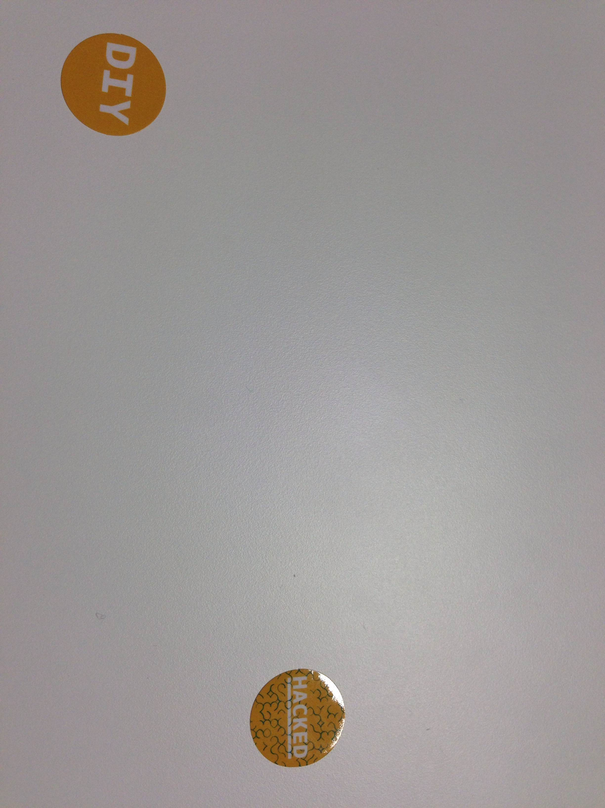
Robootika lahenduste esitlus
Raul Liinev
Martin Ligema
Siim Suu
Martin Tõnne

Slide 2
Idee
Arduino, ColorPal, Joystick ja tinkerkit seadmete kombineerimine õppimise eesmärgil.

Slide 3
Kasutus
Arduino, ColorPal, Joystick ja tinkerkit seadmete kombineerimine. Värvide skännimine ja nende liigutamine veebis.

Slide 4
Arendus
Arduino, ColorPal, Joystick ja tinkerkit seadmete kombineerimine. Värvide skännimine ja nende liigutamine veebis.

Slide 5

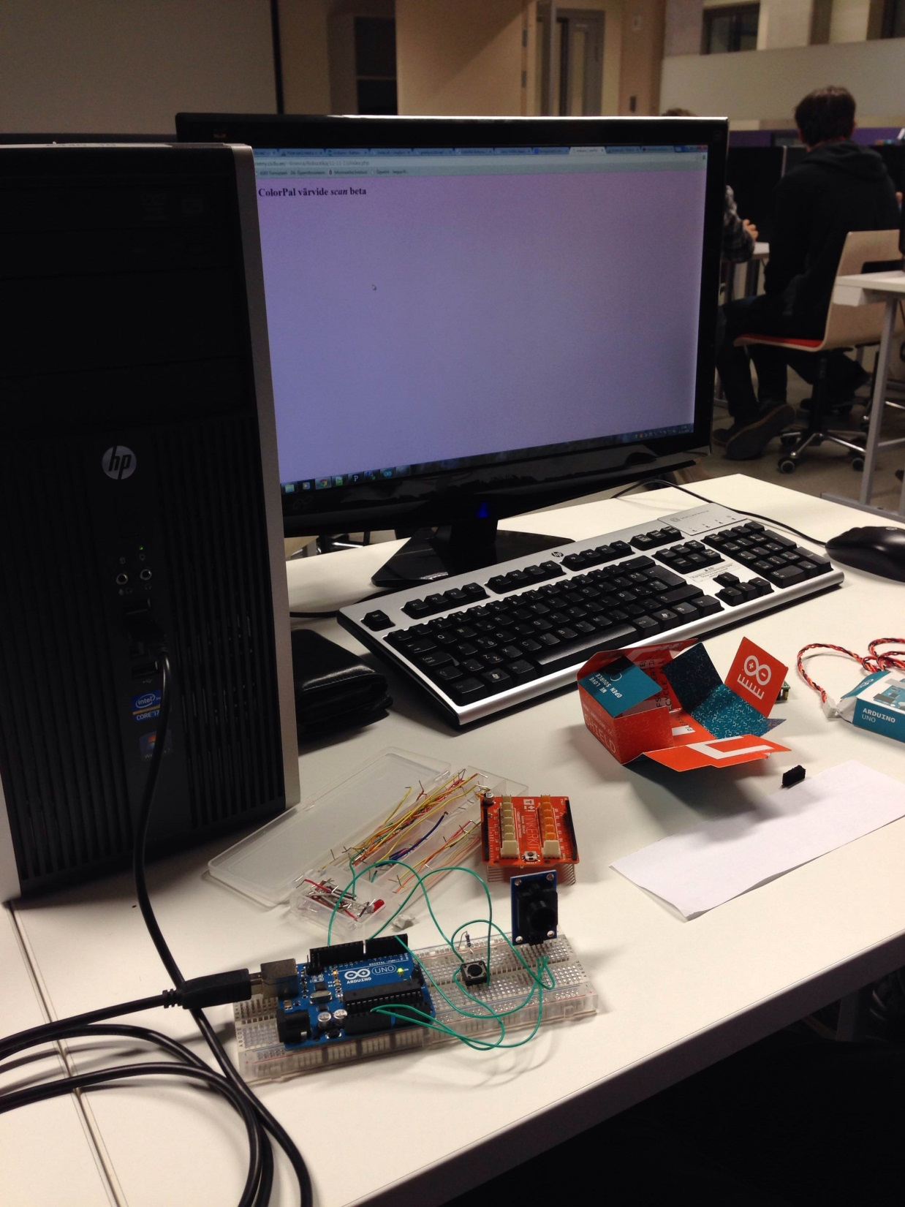

Slide 11
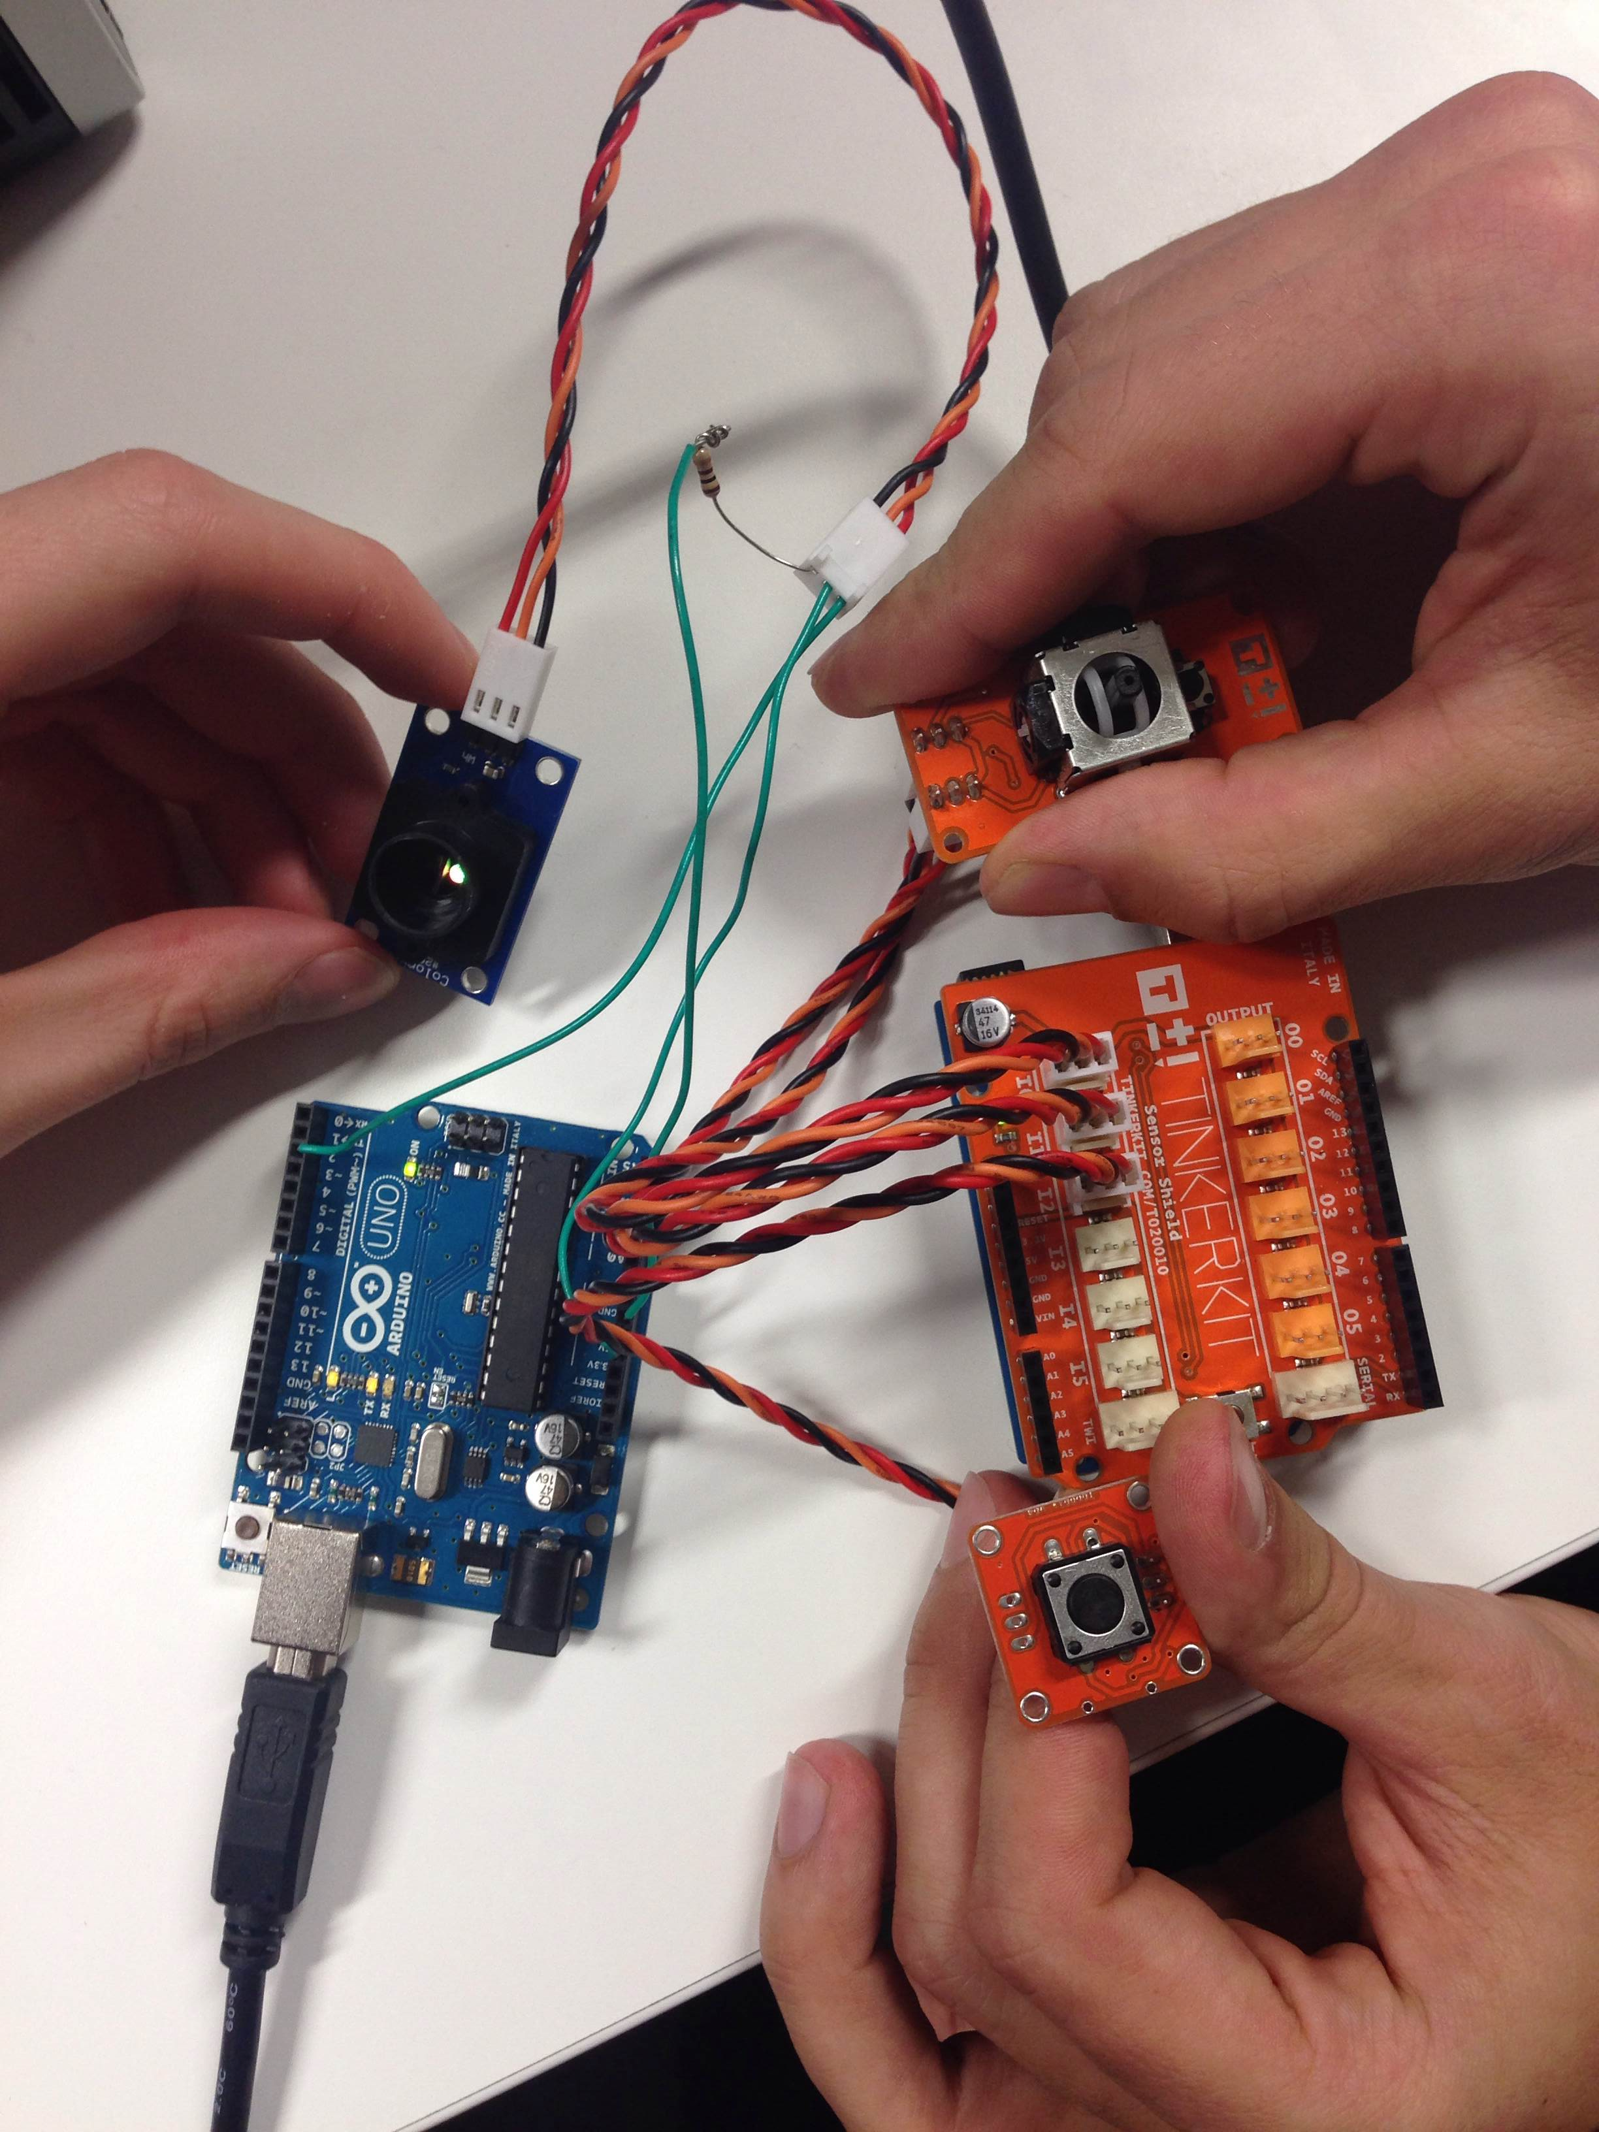

Slide 12
KOOD

Slide 13
ARDUINO.TXT
#include <SoftwareSerial.h>
const int sio = 2; // ColorPAL connected to pin 2
const int unused = 255; // Non-existant pin # for SoftwareSerial
const int sioBaud = 4800;
const int waitDelay = 200;
// Received RGB values from ColorPAL
int red;
int grn;
int blu;
#include <TinkerKit.h>
TKButton button(I2);
TKLightSensor ldr(I1);
TKJoystick joystick(I0, I1);
int x = 0;
int y = 0;
char buf[10];
// Set up two software serials on the same pin.
SoftwareSerial serin(sio, unused);
SoftwareSerial serout(unused, sio);
void setup() {
Serial.begin(9600);
// reset(); // Send reset to ColorPal
serout.begin(sioBaud);
pinMode(sio, OUTPUT);
serout.print("= (00 $ m) !"); // Loop print values, see ColorPAL documentation
serout.end(); // Discontinue serial port for transmitting
serin.begin(sioBaud); // Set up serial port for receiving
pinMode(sio, INPUT);
}
void loop() {
//delay(2000);
if (button.readSwitch() == HIGH) {
x = joystick.readX();
y = joystick.readY();
sprintf(buf, "%d,", x);
Serial.print(buf);
sprintf(buf, "%d", y);
Serial.println(buf);
delay(500) ;
//Serial.println(ldr.read());
//readData();
}
}
// Reset ColorPAL; see ColorPAL documentation for sequence
void reset() {
delay(200);
pinMode(sio, OUTPUT);
digitalWrite(sio, LOW);
pinMode(sio, INPUT);
while (digitalRead(sio) != HIGH);
pinMode(sio, OUTPUT);
digitalWrite(sio, LOW);
delay(80);
pinMode(sio, INPUT);
delay(waitDelay);
}
void readData() {
char buffer[32];
if (serin.available() > 0) {
// Wait for a $ character, then read three 3 digit hex numbers
buffer[0] = serin.read();
if (buffer[0] == '$') {
for(int i = 0; i < 9; i++) {
while (serin.available() == 0); // Wait for next input character
buffer[i] = serin.read();
if (buffer[i] == '$') // Return early if $ character encountered
return;
}
parseAndPrint(buffer);
delay(10);
}
}
}
// Parse the hex data into integers
void parseAndPrint(char * data) {
sscanf (data, "%3x%3x%3x", &red, &grn, &blu);
char buffer[32];
sprintf(buffer, "%4.4d_%4.4d_%4.4d", red, grn, blu);
Serial.println(buffer);
}

Slide 14
PROCESS.TXT
import processing.serial.*;
Serial myPort; // The serial port
int xPos = 1; // horizontal position of the graph
void setup () {
// set the window size:
size(400, 300);
// List all the available serial ports
println(Serial.list());
// I know that the first port in the serial list on my mac
// is always my Arduino, so I open Serial.list()[0].
// Open whatever port is the one you're using.
myPort = new Serial(this, Serial.list()[2], 9600);
// don't generate a serialEvent() unless you get a newline character:
myPort.bufferUntil('\n');
// set inital background:
background(0);
}
void draw () {
}
void serialEvent (Serial myPort) {
// get the ASCII string:
String inString = myPort.readStringUntil('\n');
loadStrings("http://greeny.cs.tlu.ee/~liinevra/Robootika/11-11-13/index2.php/?tekst="+inString);
if (inString != null) {
println(inString);
}
}

Slide 15
KOOD

