Slide 2
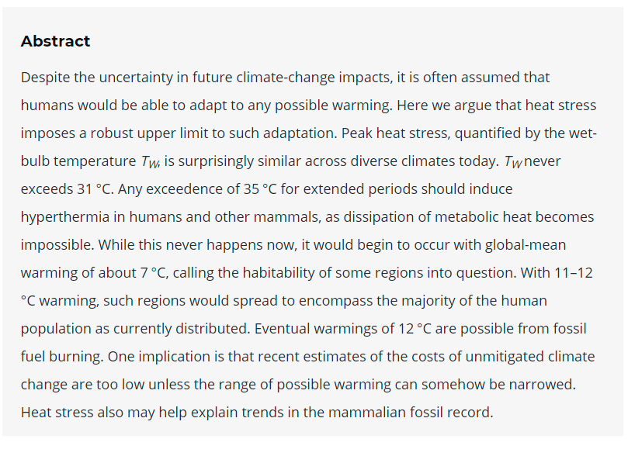
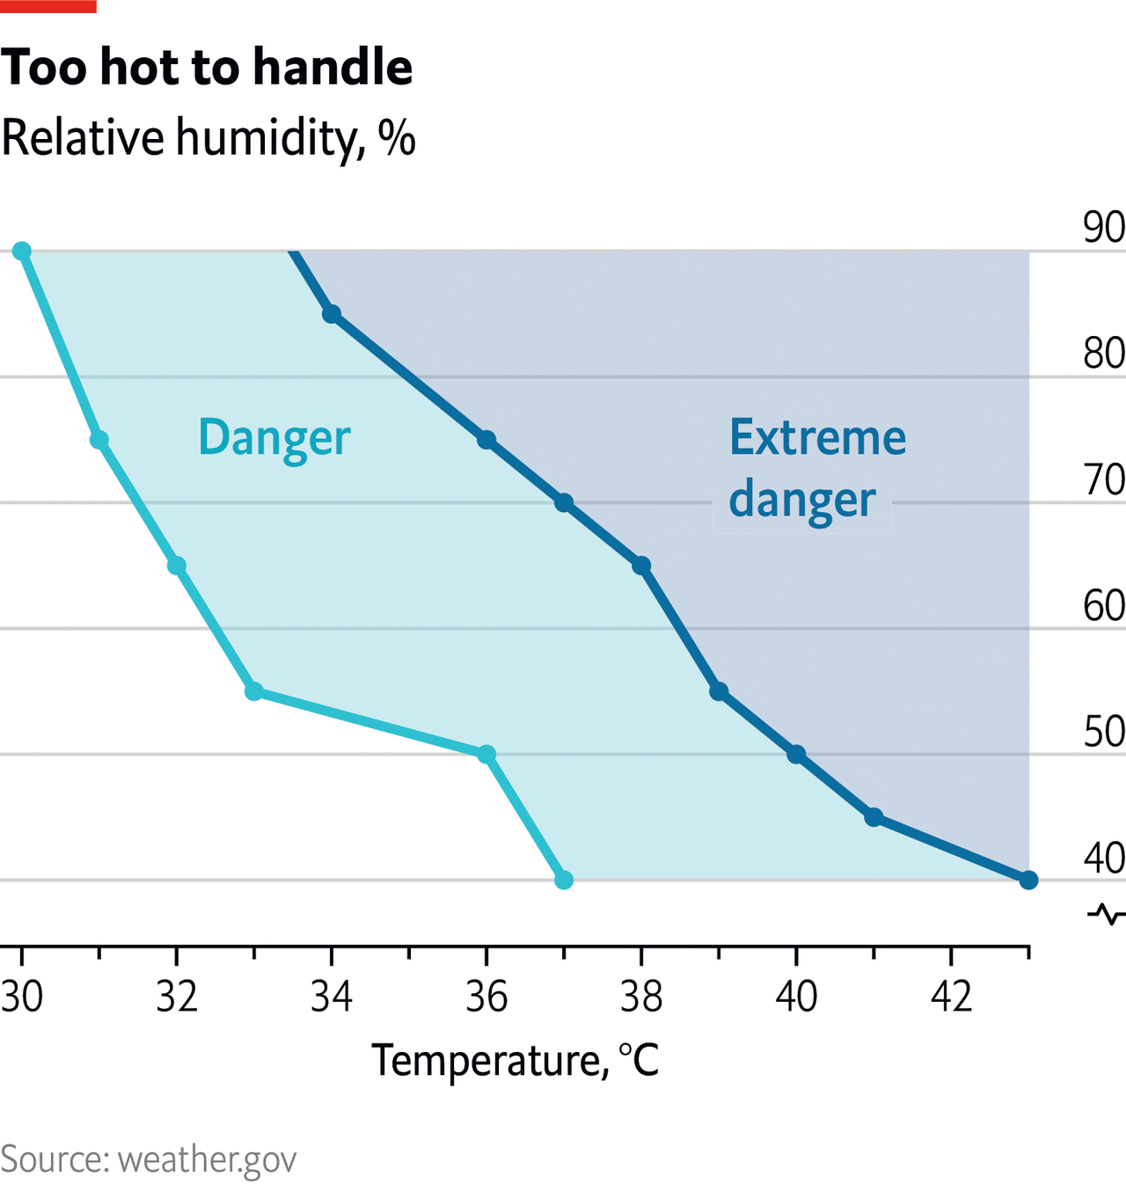
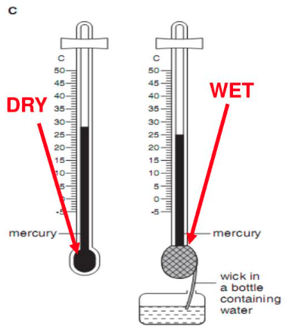
Märja termomeetri temperatuur (Wet bulb temperature)
The wet-bulb temperature is the lowest temperature that can be reached under current ambient conditions by the evaporation of water only. Even heat-adapted people cannot carry out normal outdoor activities past a wet-bulb temperature of 32-35 °C, equivalent to a heat index of 55 °C.
Sherwood, S. C. & Huber, M. 2010. An adaptability limit to climate change due to heat stress. PNAS. 107 (21) 9552-9555
Notes:
The wet bulb temperature is always lower than the dry bulb temperature but will be identical with 100% relative humidity (the air is at the saturation line).
An adaptability limit to climate change due to heat stress
Steven C. Sherwood s.sherwood@unsw.edu.au and Matthew Huber
Sherwood, S. C. & Huber, M. 2010. An adaptability limit to climate change due to heat stress. PNAS. 107 (21) 9552-9555

Slide 3
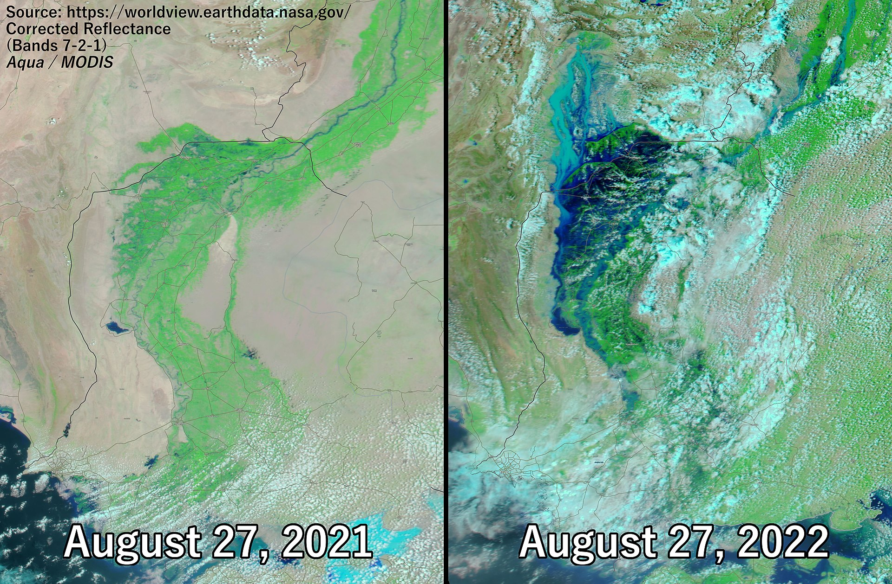
Kliimamuutuste mõju - üleujutused
Clausius-Clapeyron relationship -atmospheric water content increases by 6-7% per 1 °C. Therefore, even just an increase of 1.5°C could result in ~9% more water in the atmosphere.
climate.nasa.gov
Notes:
Clausius-Clapeyron relationship, atmospheric water content increases by between 6 and 7% per 1 °C. Therefore, even just an increase of 1.5°C could result in ~9% more water in the atmosphere, which could have a major impact on storm systems and subsequent rainfall.

