Slide 1
Automobile
Name Surname

Slide 2
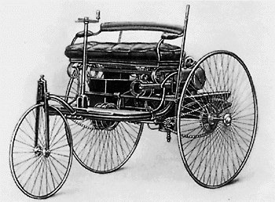
Automobile
Etymology
History

Slide 3
Seating and body style
Sedan
  Notchback sedans
  Fastback sedans
  Hardtop sedans
  Hatchback sedans
  Chauffeured sedans
Hatchback
Station Wagon
Minivan

Slide 4
Cars in Estonia

Slide 5
Thank You!

